Slide 1




ScreenID: Enhancing QRCode Security by Fingerprinting Screens
Yijie Li#, Yi-Chao Chen#, Xiaoyu Ji*, Hao Pan#, Lanqing Yang#,
Guangtao Xue#, Jiadi Yu#
Shanghai Jiao Tong University#
Zhejiang University*
Notes:
各位华为的老师们下午好，今天我想要报告一下

Slide 2
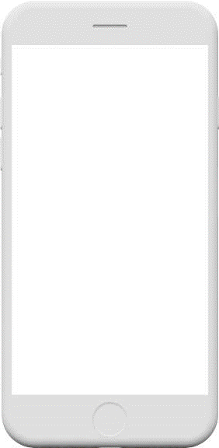
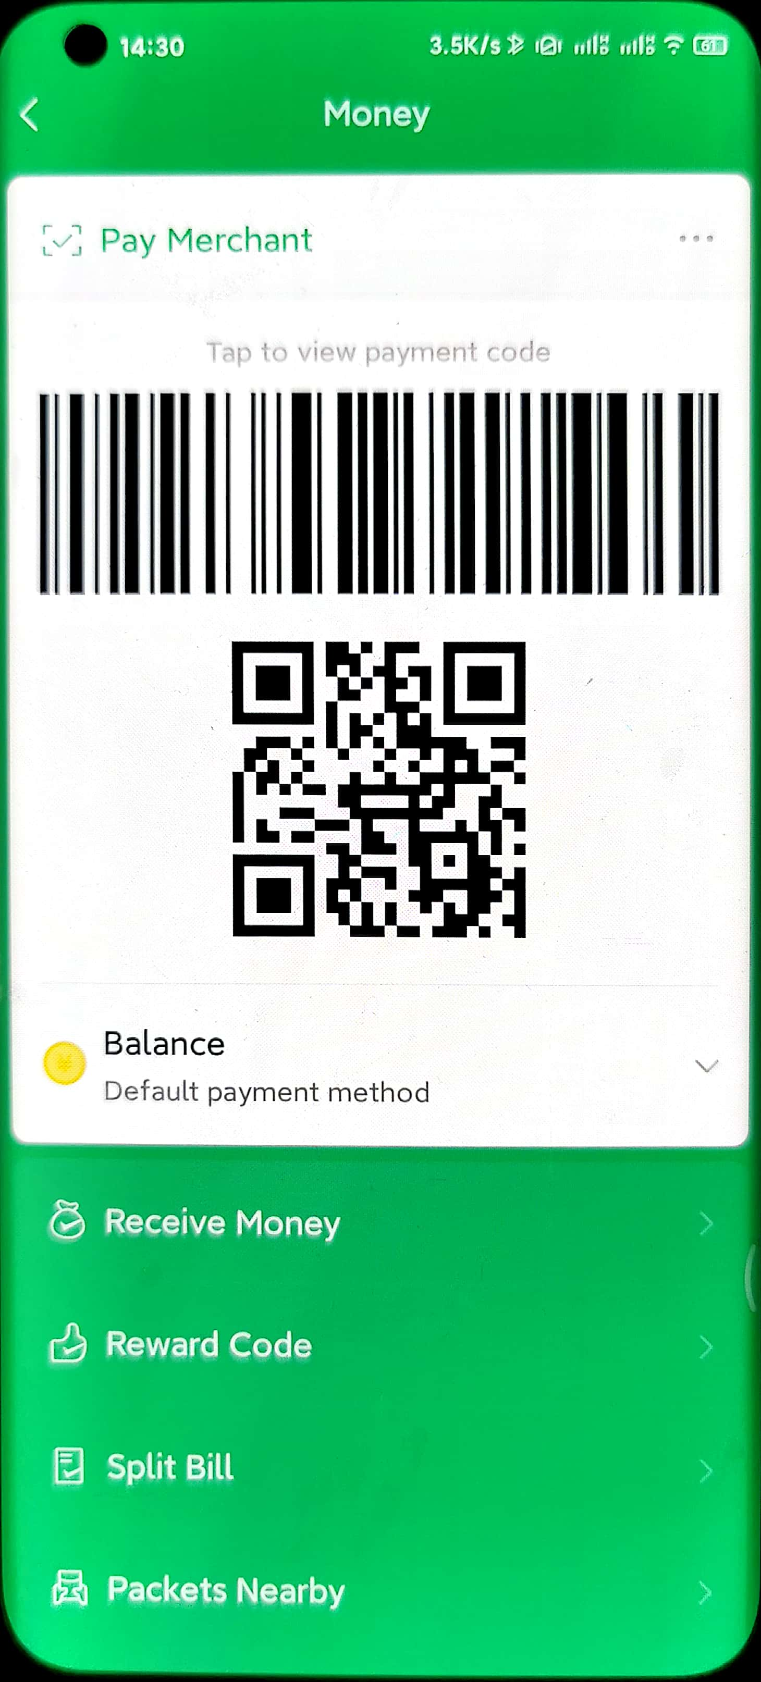


Payment
Advertisements
Social E-cards

Slide 3
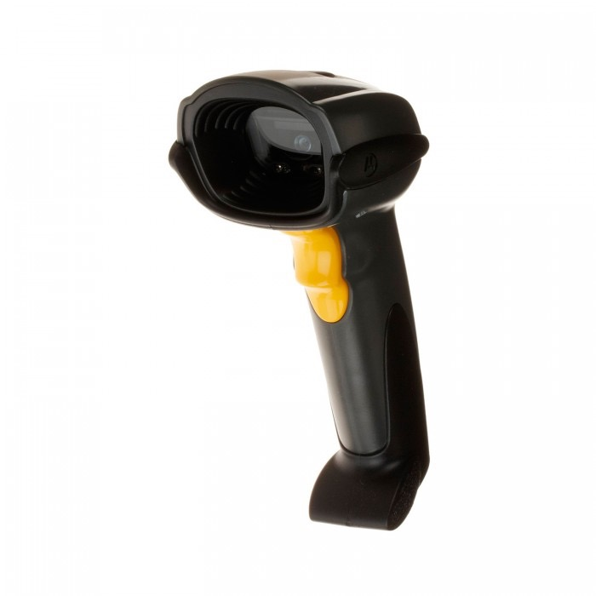
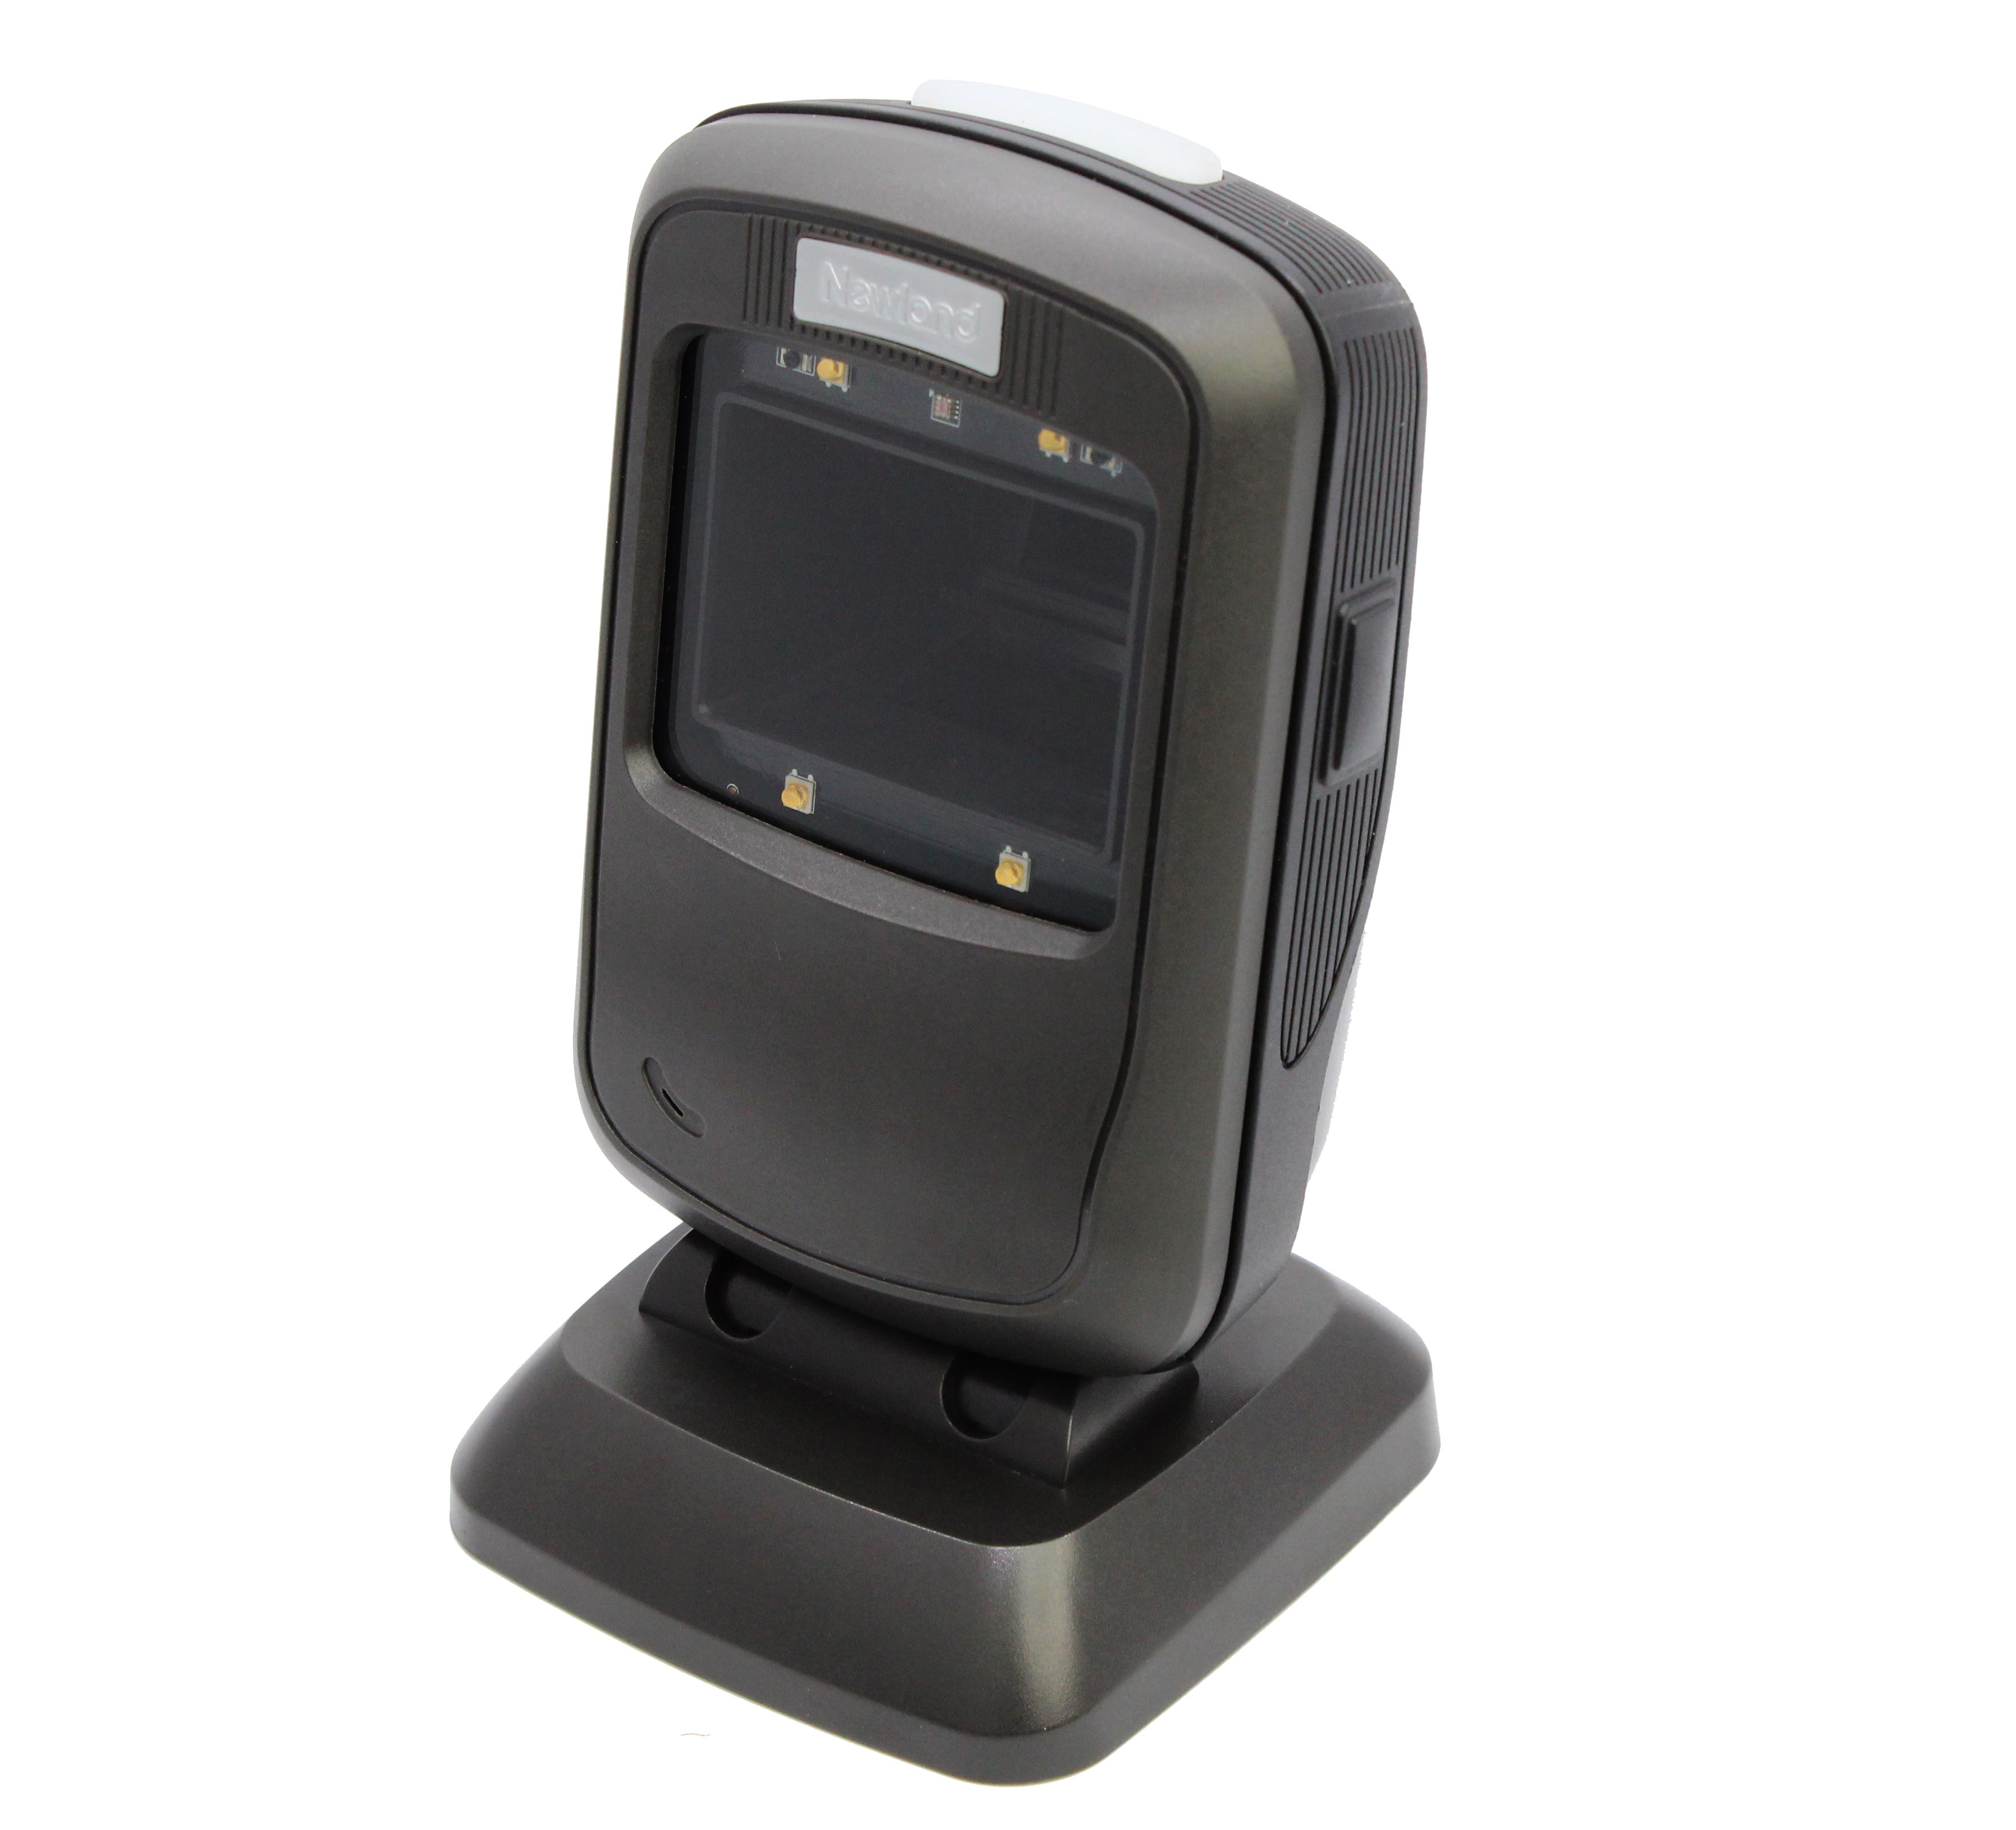


Camera

Slide 4










Replay Attack in a Mobile Payment Scenario
Pre-deployed Camera
Cashier
Customers
Malware
Sniffing

Slide 5



Replay Attack in a Mobile Payment Scenario
Other Cashiers
or Customized Software
Attackers

Slide 6
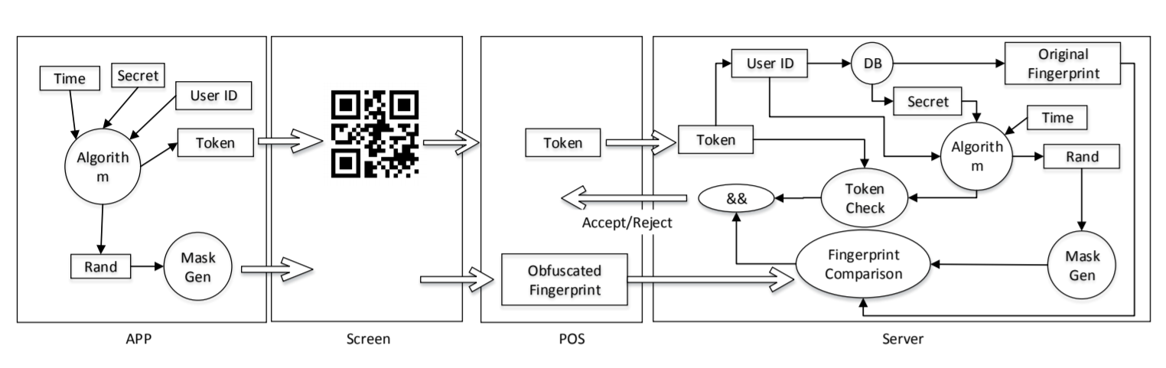
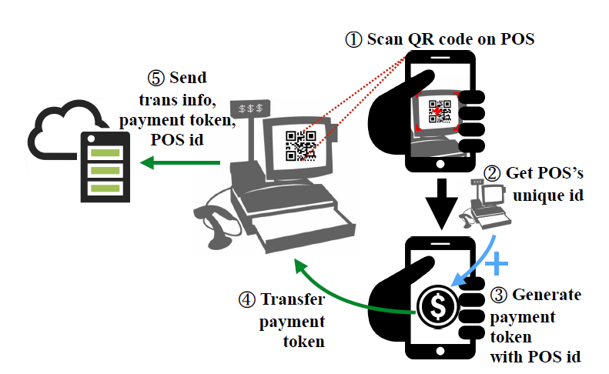
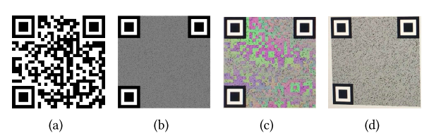
Existing Solutions
Aging Problem
Change User’s Habit
AnonPoint (ACSAC 18’)
Fixed Position
POSAUTH (USENIX 17’)
mQRCode (Mobicom 19’)

Slide 7



PWM
Frequency
≠
Transaction Denied!
Cashier
Authorized Phone
Attackers’
Phone

Slide 8

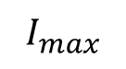
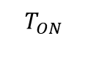
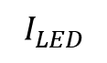
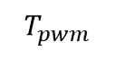
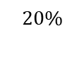
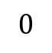
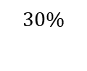
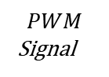
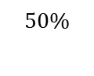
Working Principle of Pulse Width Modulation
Flicker
Brightness
Screen Brightness Control Using PWM
$$50\%$$
$$30\%$$
$$20\%$$
$$PWM$$
Signal
$$T_{ON}$$
$$T_{pwm}$$
$$I_{max}$$
$$PWM Dimming$$
$$I_{LED}$$
$$0$$

Slide 9
Working Principle of Pulse Width Modulation
Flicker
Brightness
Screen Brightness Control Using PWM
$$50\%$$
$$30\%$$
$$20\%$$
$$PWM$$
Signal
$$T_{ON}$$
$$T_{pwm}$$
$$I_{max}$$
$$PWM Dimming$$
$$I_{LED}$$
$$0$$

Slide 10
Working Principle of Pulse Width Modulation
Flicker
Brightness
Screen Brightness Control Using PWM
$$50\%$$
$$30\%$$
$$20\%$$
$$PWM$$
Signal
$$T_{ON}$$
$$T_{pwm}$$
$$I_{max}$$
$$PWM Dimming$$
$$I_{LED}$$
$$0$$

Slide 11
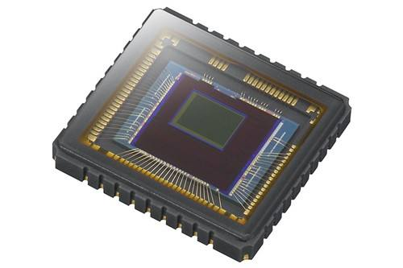
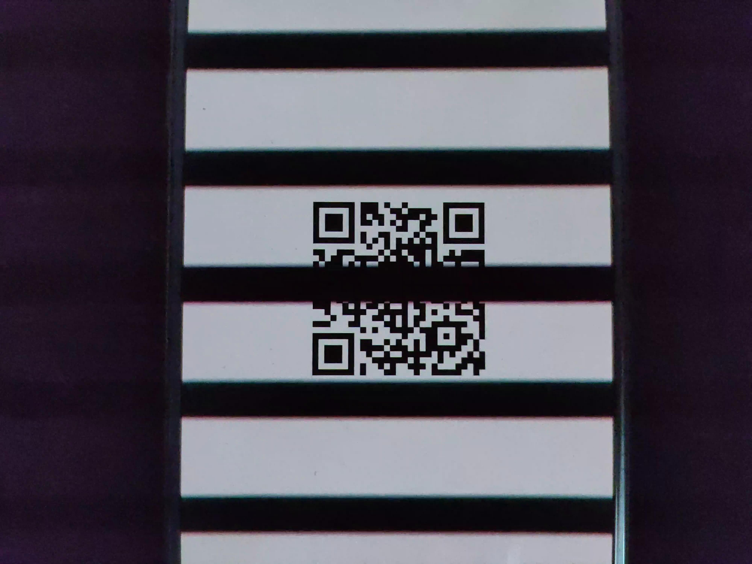
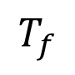
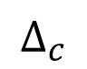
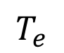
Communication Between Screen and Camera
CMOS
Rows
$$T_{e}$$
$$∆_{c}$$
Time
$$T_{f}$$
Brightness control using PWM

Slide 12

Communication Between Screen and Camera
CMOS
Eyes
Rows
$$T_{e}$$
$$∆_{c}$$
Time
$$T_{f}$$
Brightness control using PWM

Slide 13

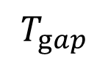
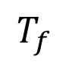
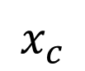
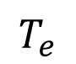
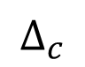
Communication Between Screen and Camera
PWM Signal
White stripe
$$T_{gap}$$
$$x_{c}$$
$$∆_{c}$$
$$T_{e}$$
Black stripe
Time
Camera sensor
$$T_{f}$$

Slide 14
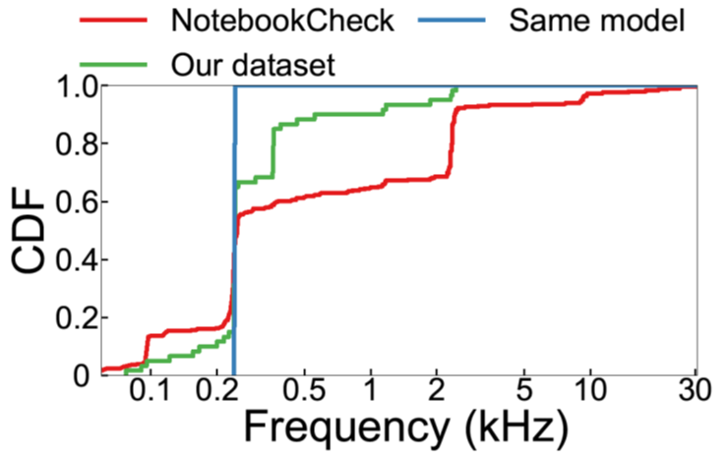
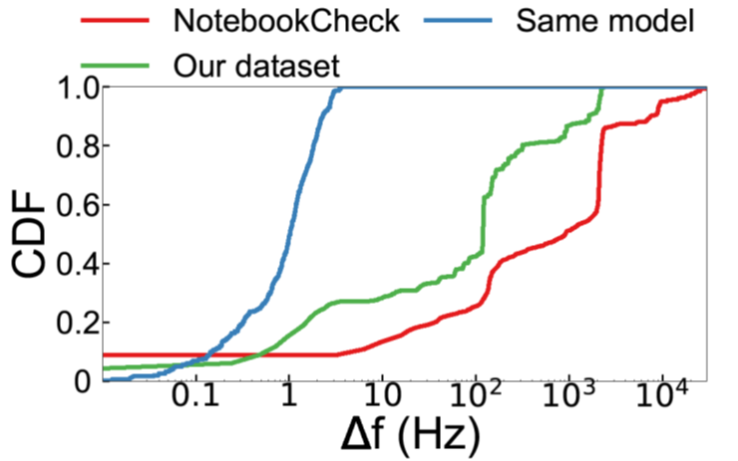
We select PWM frequency as fingerprint…
CDF of PWM frequencies and pairwise differences of 300 screens reported in NotebookCheck and 50 screens (16 are of the same model) we collected.

Slide 15
We select PWM frequency as fingerprint…
0.1 Hz can differentiate 99.3% screens in our dataset and 96% across the same model.
CDF of PWM frequencies and pairwise differences of 300 screens reported in NotebookCheck and 50 screens (16 are of the same model) we collected.

Slide 16
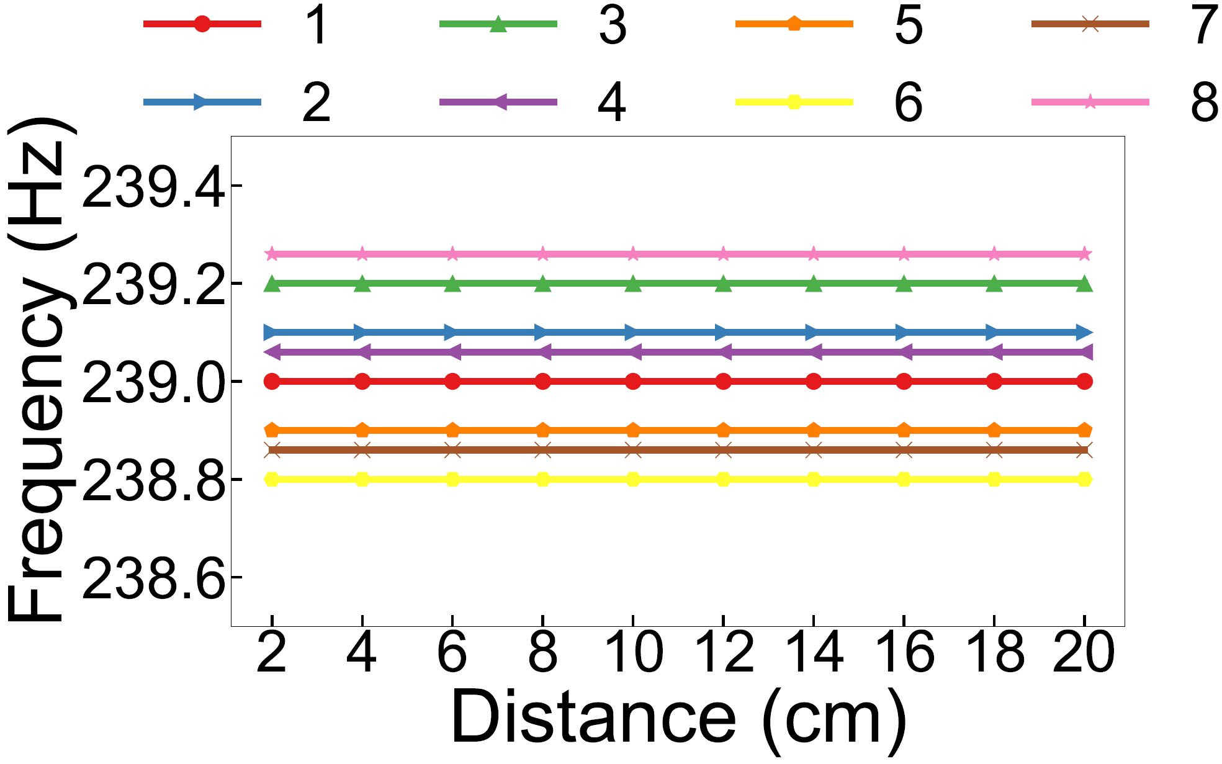
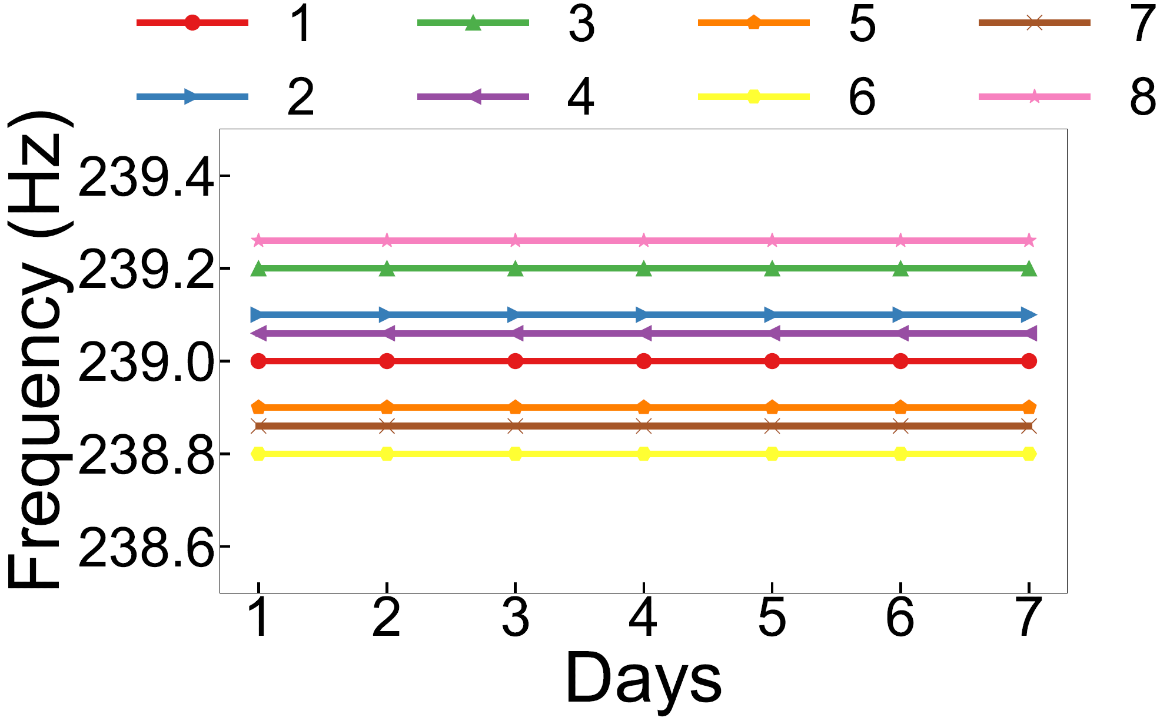
We select PWM frequency as fingerprint…
We measure the PWM frequencies using light sensor of 8 screens of the same model across days and at various distances to show its stability.

Slide 17
We select PWM frequency as fingerprint…
PWM frequency is stable across distance and time
We measure the PWM frequencies using light sensor of 8 screens of the same model across days and at various distances to show its stability.

Slide 18
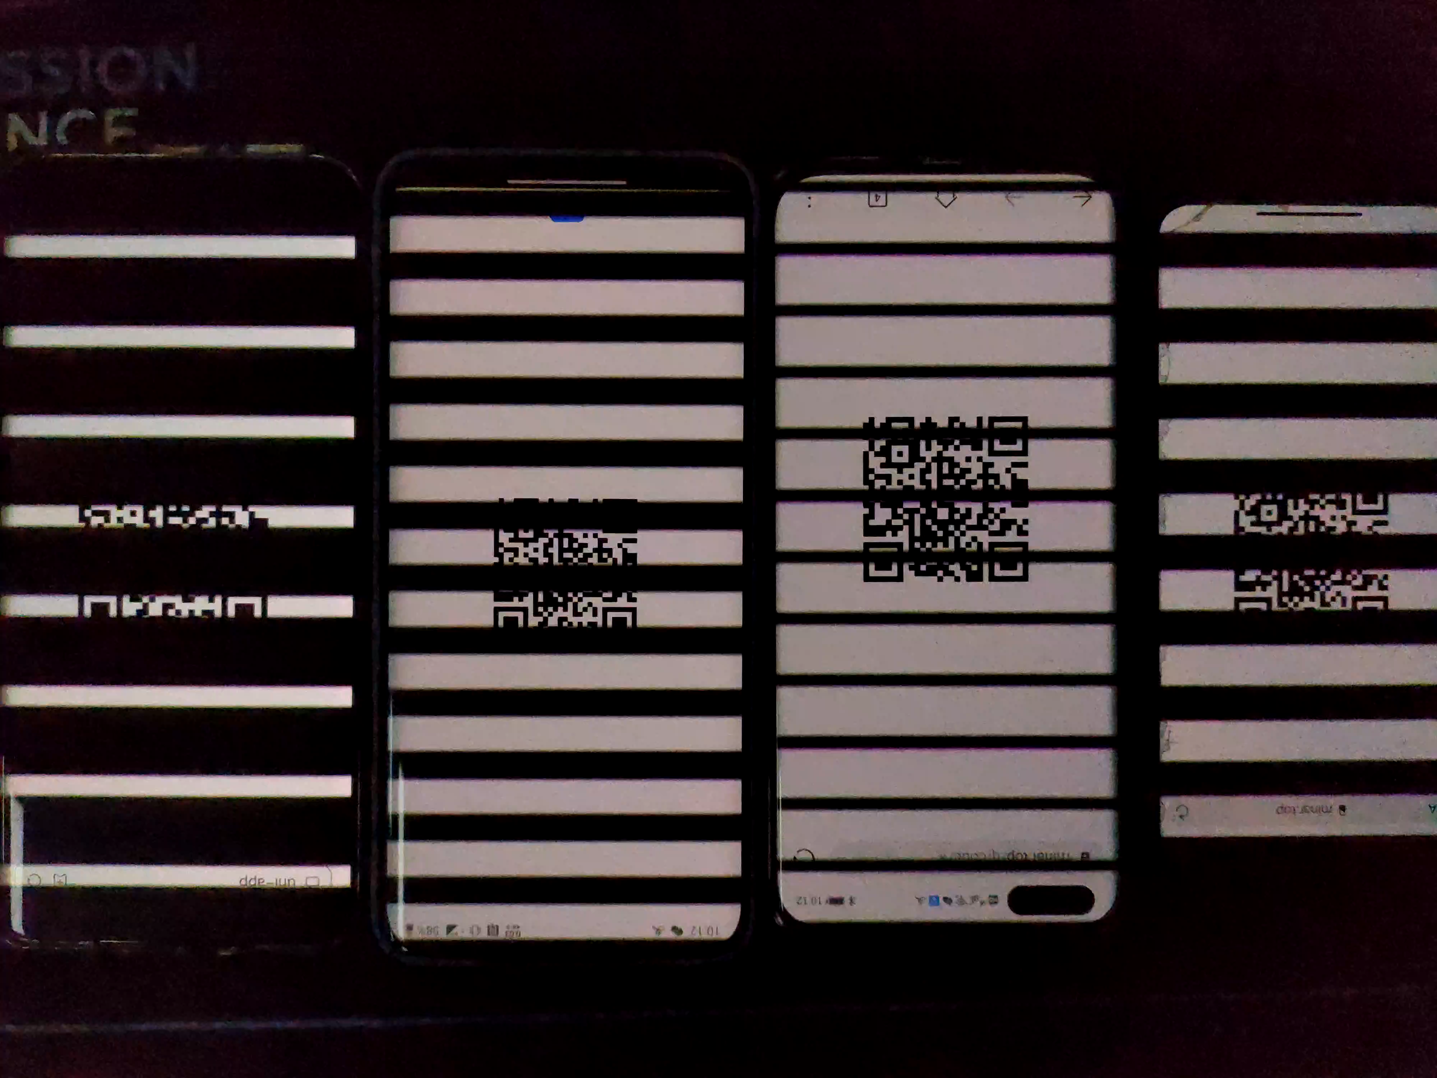
We select PWM frequency as fingerprint…
481.32Hz 359.01Hz 361.5Hz 239.88Hz

Slide 19

0.1Hz
99.3%
Screens
Pairwise differences of 300 screens

Slide 20
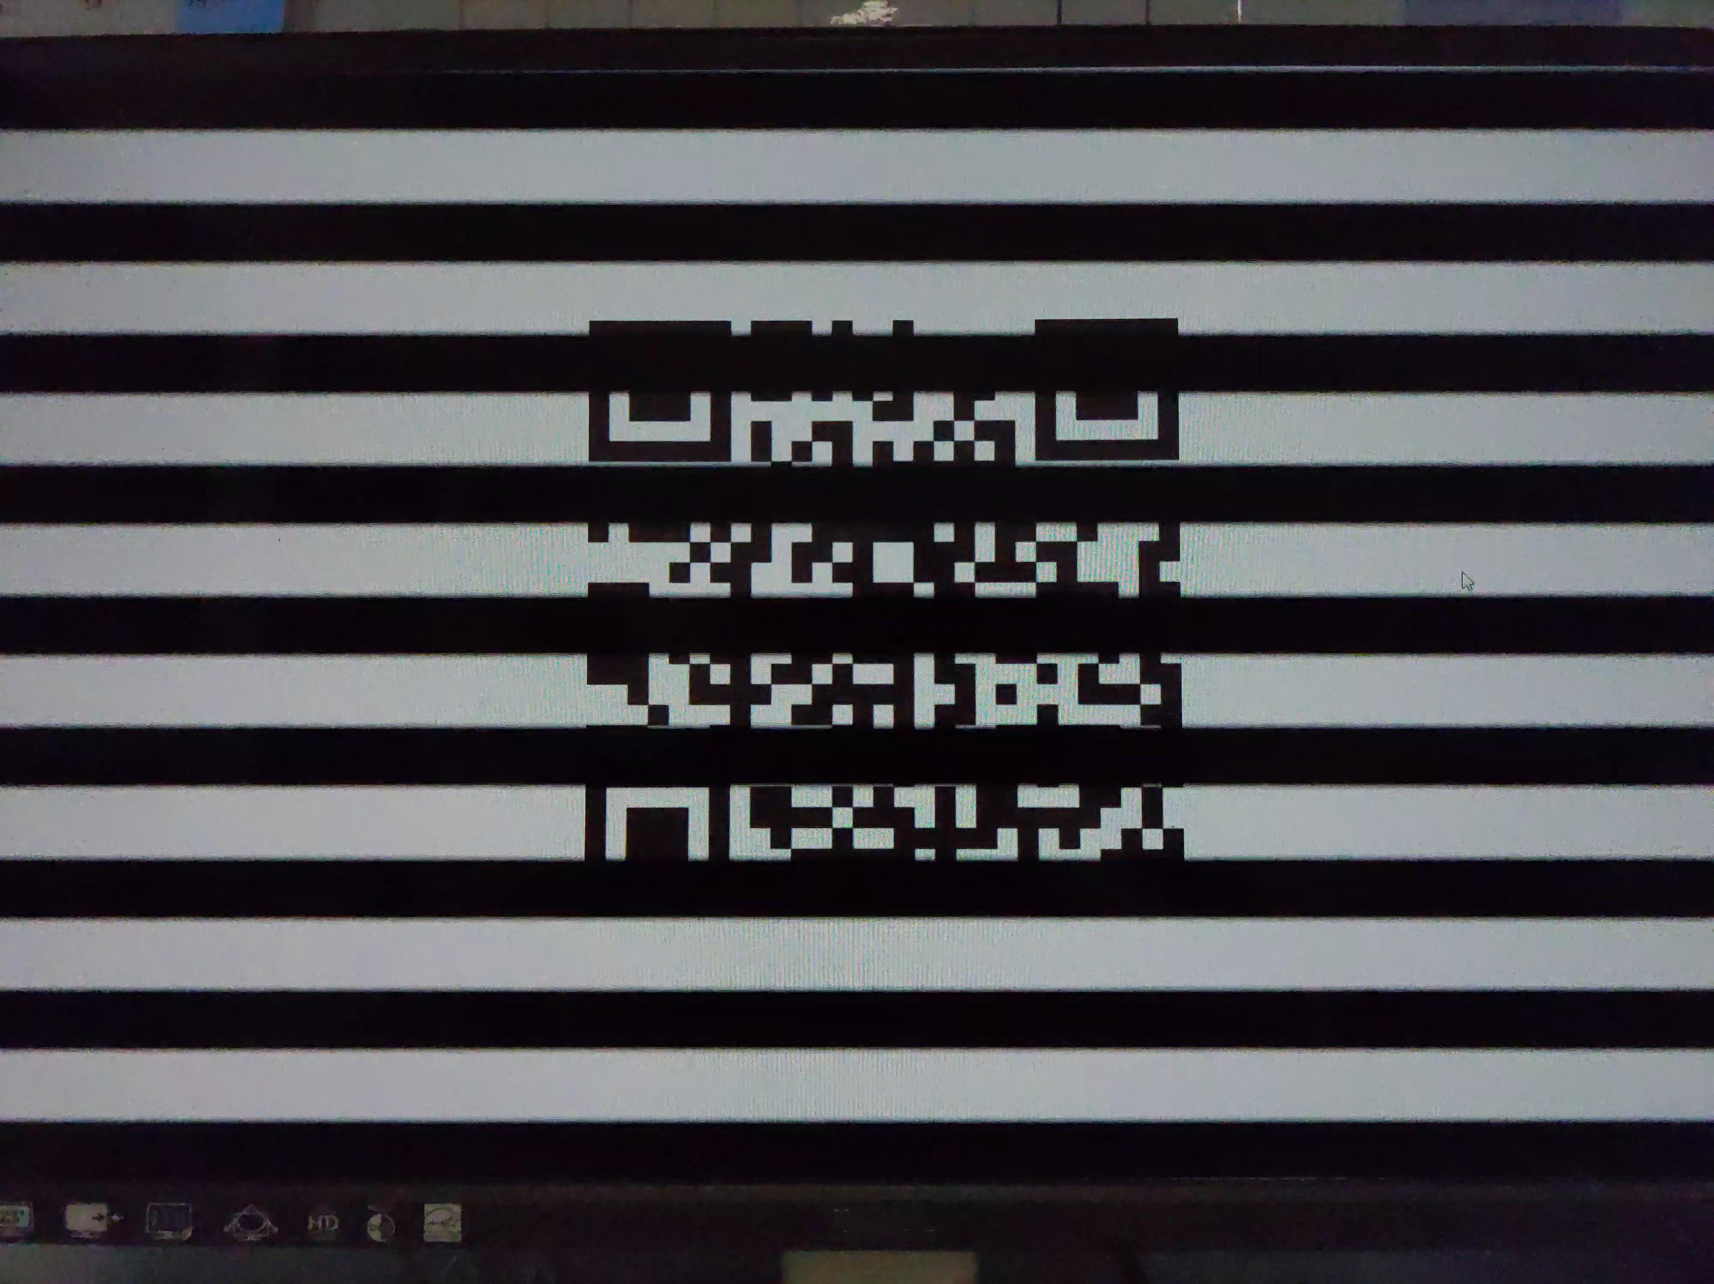
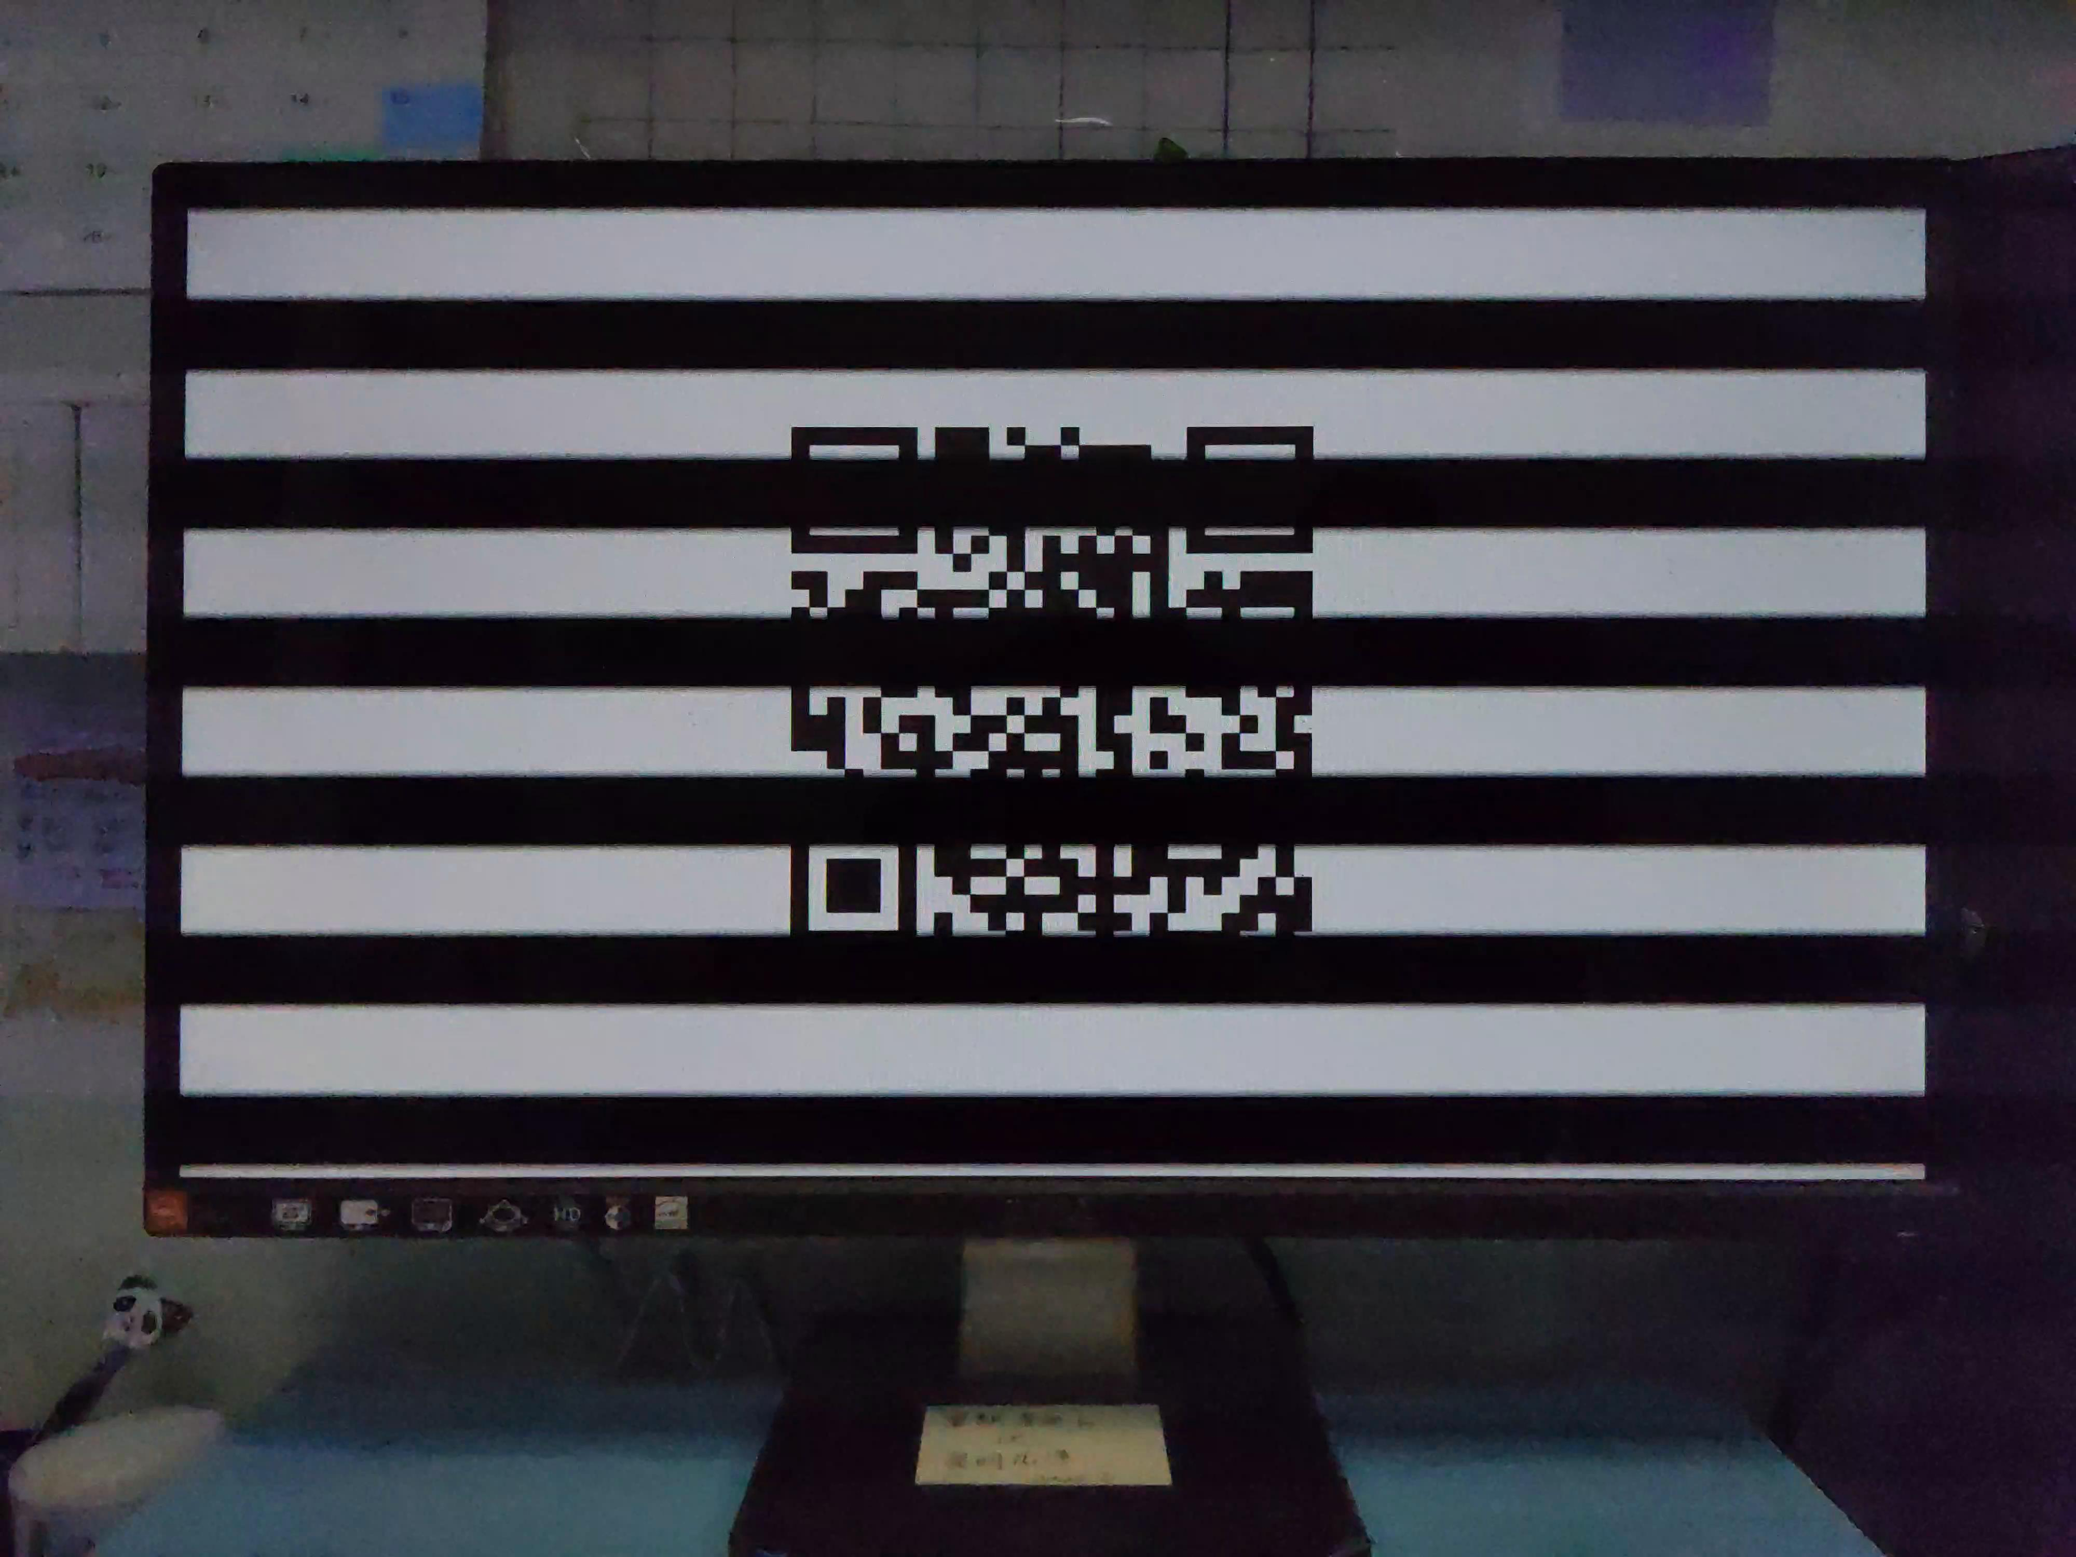
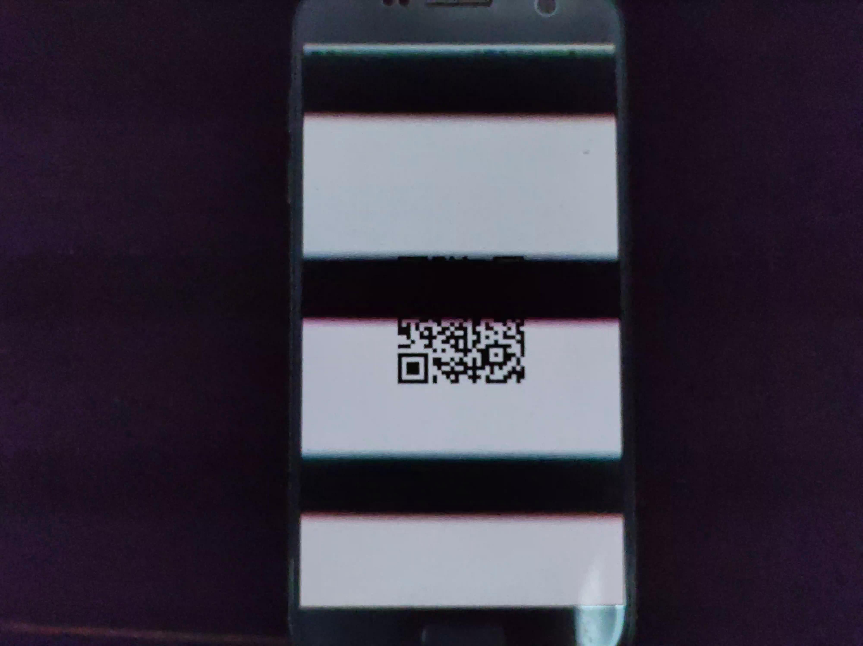
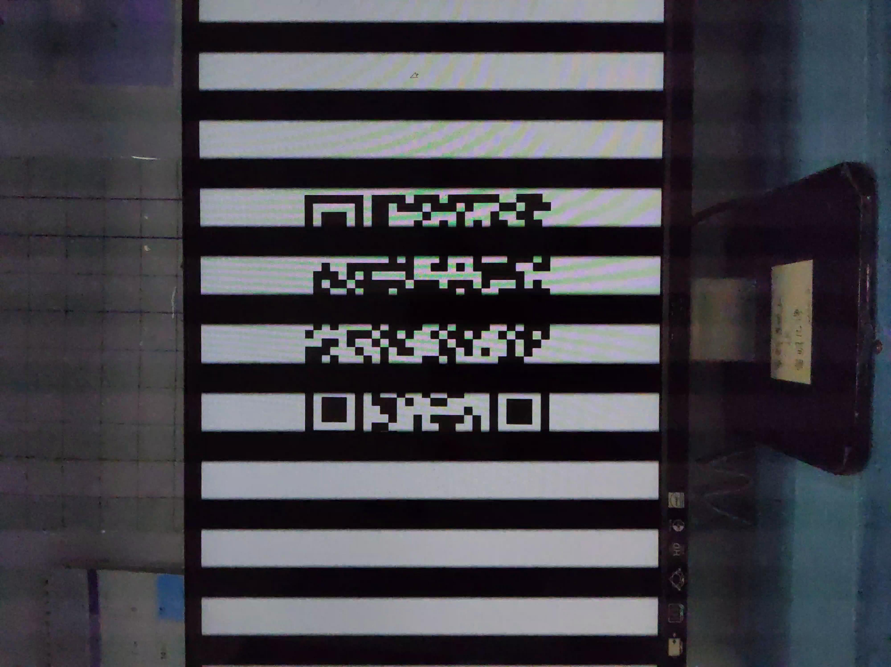
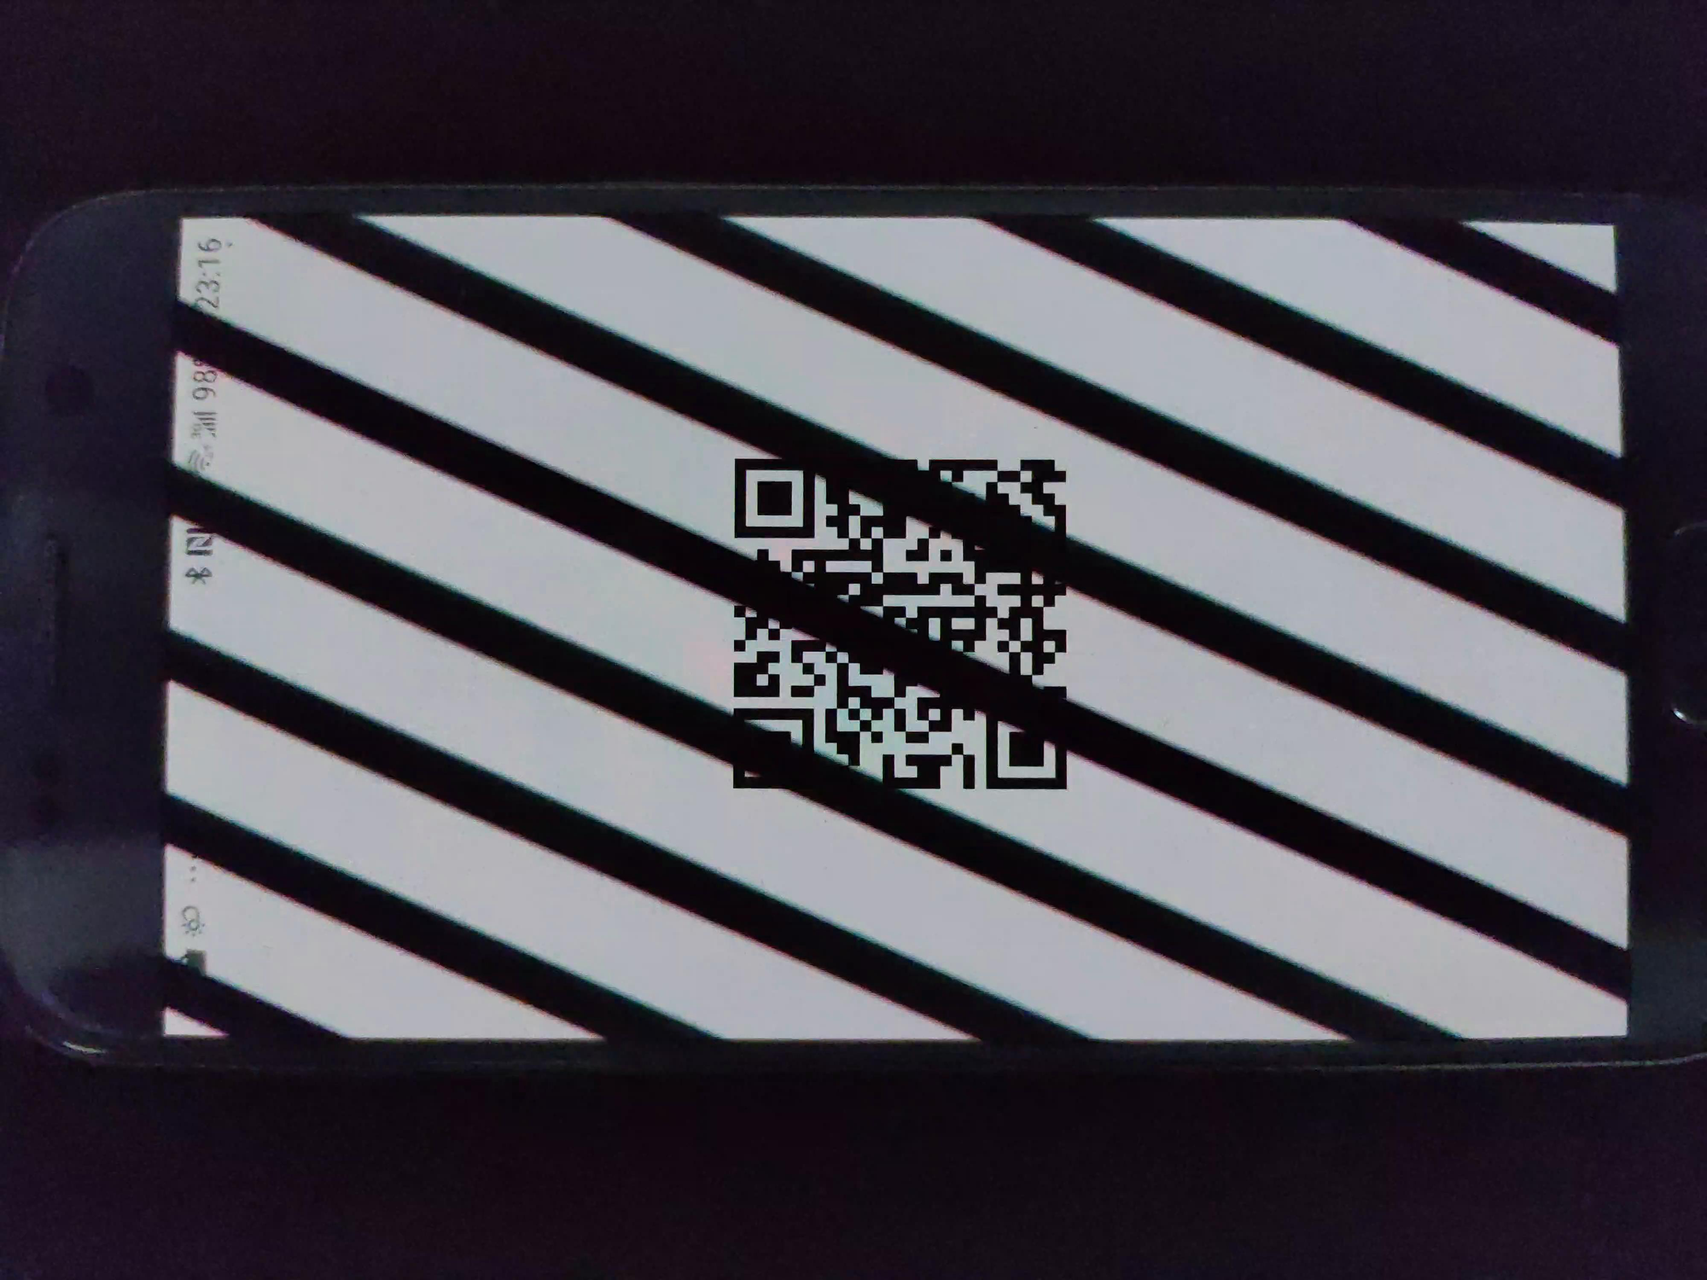
Modelling the Sampling Process
LCD
OLED
The pattern varies from distance and angle.
Not Only PWM frequency!
Close
Far
Orthogonal

Slide 21
Modelling the Sampling Process
Each row lights
asynchronously for OLED screens
LCD screen
OLED screen

Slide 22
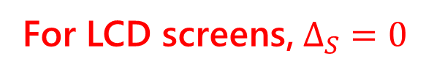
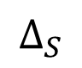
Modelling the Sampling Process
Modelling Transmitter
PWM dimming for OLED screens
Rows
$$T\left(x_{s},t\right)= cos (2πf_{pwm}\left(t+x_{s}Δ_{S}\right)+θ)$$
Row
num
$$∆_{S}$$
Signal Transmit
PWM
frequency
PWM
latency
For LCD screens, $Δ_{S}=0$
Time

Slide 23
Modelling the Sampling Process
Sampled by the camera
Rows
$$∆_{S}$$
k
Time
OLED screen

Slide 24
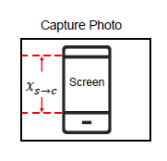
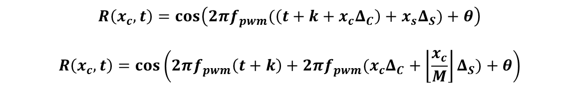
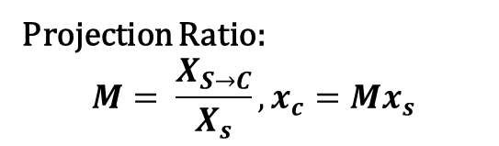
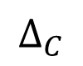
Modelling the Sampling Process
Sampled by the camera
Projection Ratio:
$$M= \frac{X_{S→C}}{X_{s}}, x_{c}=Mx_{s}$$
Rows
$$R\left(x_{c}, t\right)=\cos\left(2πf_{pwm}(\left(t+k+x_{c}Δ_{C}\right)+x_{s}Δ_{S})+θ\right)$$
$$R\left(x_{c}, t\right)=\cos\left(2πf_{pwm}\left(t+k\right)+2πf_{pwm}(x_{c}Δ_{C}+\left\lfloor \frac{x_{c}}{M}\right\rfloor Δ_{S})+θ\right)$$
$$∆_{S}$$
Signal Receive
Sampling
Begin time
Rolling shutter
interval
k
$$∆_{C}$$
Time

Slide 25
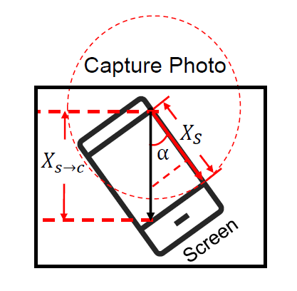
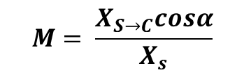
Modelling the Sampling Process
Modelling
Receiver in a frame
Sampled by the camera
Rows
$$M= \frac{X_{S→C}cosα}{X_{s}}$$
$$R\left(x_{c}, t\right)=\cos\left(2πf_{pwm}\left(t+k\right)+2πf_{pwm}(x_{c}Δ_{C}+\left\lfloor \frac{x_{c}cosα}{M}\right\rfloor Δ_{S})+θ\right)$$
$$∆_{S}$$
Signal Receive
Sampling
Begin time
Rolling shutter
interval
k
$$∆_{C}$$
Time

Slide 26
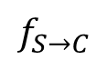
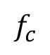

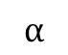

Modelling the Sampling Process
$$α$$
$$f_{S→C}$$
$$f_{c}$$
$$φ$$
$$φ$$
$$f_{c}=\frac{1}{Δ_{C}},f_{S}=\frac{1}{Δ_{S}}, f_{S→C}=f_{s}M$$
$$tanφ=\frac{f_{S→C} cosα+f_{c}}{f_{S→C}sinα}=\frac{Δ_{C}Mcosα+Δ_{S}}{Δ_{C}Msinα}$$
$$Particularly, tanφ=\frac{Δ_{S}}{Δ_{C}M}, when α=90°$$

Slide 27
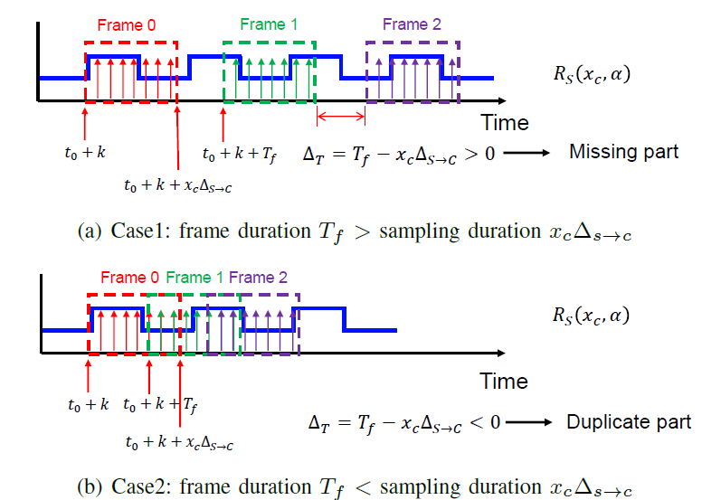
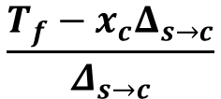
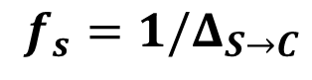

Improving Frequency Resolution
Frame Concatenation for distinguishing more screens.
$$R\left(x_{c}, t,α,n\right)=\cos\left(2πf_{pwm}\left(t+nT_{f}+k\right)+2πf_{pwm}(x_{c}Δ_{C}+\left\lfloor \frac{x_{c}cosα}{M}\right\rfloor Δ_{S})+θ\right)$$
$$R\left(x_{c}, t,α,n\right)=\cos\left(2πf_{pwm}(x_{c}Δ_{C}+\left\lfloor \frac{x_{c}cosα}{M}\right\rfloor Δ_{S})+θ{+θ}_{0}\right)$$
True sampling interval
$$Δ_{S→C}=\frac{x_{c}Δ_{C}+\left\lfloor \frac{x_{c}cosα}{M}\right\rfloor Δ_{S}}{x_{c}}$$
True sampling rate
$$f_{s}=1/Δ_{S→C}$$
Missing length
Duplicate length
$$\frac{T_{f}−x_{c}Δ_{s→c}}{Δ_{s→c}}$$

Slide 28

System Overview

Slide 29



System Overview
Encoding：
Step 1: Register $f_{pwm}$ at the first time.
Step 2: Obtain $Δ_{S}$ using a pre-set camera ($Δ_{C} is known$)
$$tanφ=\frac{Δ_{S}}{Δ_{C}M}$$
$$φ$$
Step 3: Encode parameters into a fixed size QR code (580×580 pixel).

Slide 30


System Overview
Decoding – for camera ：
Step 1: Calibrate rolling shutter interval ($Δ_{C}$) using a LCD screen with known $f_{pwm}$.
$$W_{lcd}$$
$$Δ_{C}=\frac{1}{f_{pwm}W_{lcd}}$$
LCD screen
Step 2: Camera Configuration
Auto-mode for capturing a photo
Exposure time: 0.3 ms, ISO: highest

Slide 31



System Overview
Step 3: Determine QR code position
Original
Contour
Rotation angle

Slide 32
System Overview
Projection
Ratio

Slide 33
System Overview
Step 3: Contour Extraction
RGB to Gray
Binarization
Sobel Operator

Slide 34


System Overview
Step 4: Multi-frame concatenation
For information loss: zero-padding
For information duplication: removing
$$\frac{T_{f}−x_{c}Δ_{s→c}}{Δ_{s→c}}$$

Slide 35


System Overview
Step 5: Frequency Extraction
Down-sampling and re-concatenation
Segment original signal ($x_{1}, x_{2}, …, x_{N}$) into K parts ($\left[x_{1}, x_{K+1},x_{2K+1},…\right],\left[x_{2}, x_{K+2},x_{2K+2},…\right],…$)
New sampling rates - $f_{s}/K$
Hanning window to make the concatenation smoother
Chirp-Z transform to improve spectral resolution.
Down Sampling
Chirp-Z Transform

Slide 36


System Overview
Step 6: Verification
Compare the estimated PWM frequency with the one embedded in the QR code.
If the difference is less than a given threshold (e.g., 0.03Hz), the QR code is accepted.
$$f_{pwm}$$
$$=$$
?

Slide 37
Thanks
For Watching!

Slide 38

Performance Evaluation
Experiment Setup and Metrics:
We generate version-3 (29×29) QR codes using ScreenID. 50 smartphone screens (10 LCD and 40 OLED) and 5 smartphone cameras are used in our evaluation. We displayed 40 QR codes where 10 for verification and the other 30 selected randomly for attack.
TPR (True Positive Rate) = $\frac{Number of accepted authorized QR code}{Number of verification attempts}$
FPR (False Positive Rate) = $\frac{Number of accepted unauthorized QR code}{Number of attack attempts}$

Slide 39


Performance Evaluation - Microbenchmark
Number of Required Frames
Verification TPR and time of different frequency extraction schemes.

Slide 40
Performance Evaluation - Microbenchmark
Number of Required Frames
Only need 60 frames (2 sec) for TPR=100% and 0.5 sec for verification processing.

Slide 41


Performance Evaluation - Microbenchmark
Camera Configuration
The TPR on impact of exposure time and ISO number under different brightness ratio

Slide 42
Performance Evaluation - Microbenchmark
Camera Configuration
Set exposure time to 0.3ms (TPR=100%) and ISO to the highest for recognition in low brightness environment..

Slide 43


Performance Evaluation - Microbenchmark
Threshold
The TPR and FPR on the impact of 50 screens we collected

Slide 44
Performance Evaluation - Microbenchmark
Threshold
We set threshold to 0.03Hz for trade-off where the average TPR is above 94% and the average FPR is below 0.8%.

Slide 45


Performance Evaluation
Overall Performance
The TPR and FPR of 50 screens where the first 30(red) are of the same model

Slide 46
Performance Evaluation
Overall Performance
Average TPR is 99.7% for all screens and 95% for the same model.
Average FPR is 1.5% for the same model and 0% for other model.

Slide 47



Performance Evaluation - Robustness
$L_{A}$: indoor with light off
$L_{B},L_{C},L_{D}$: outdoor at 9am, 12am, 5pm
$L_{E}$: indoor with light on
The robustness of ScreenID under various impact factors.

Slide 48
Performance Evaluation - Robustness
10-18 cm
> 91.3%
±5 degree
$L_{A}$: indoor with light off
$L_{B},L_{C},L_{D}$: outdoor at 9am, 12am, 5pm
$L_{E}$: indoor with light on
The robustness of ScreenID under various impact factors.

Slide 49
Conclusion
We demonstrated the feasibility of using PWM frequency of screens for fingerprint, which can enhance QR code security.
We proposed ScreenID, which incurs no additional hardware for QRCode system and no requirements for user behavior.
We proposed to model the interaction between the camera and the screen in both temporal and spatial domains and achieved high estimation accuracy.
We conducted exhaustive experiments and demonstrated the efficacy of ScreenID system under a variety of operating conditions.

